Slide 1
Uncovering Income Tax Fraud: A logistic Regression Approach for Detection and Prevention
Final review
Batch Number: ISE-G15
Roll Number​s | Student Name​s
20191ISE0126​ | RAFEEDA FATIMA​
20191ISE0134​ | RAVULUDIKI HIRE MATAM PRATHIBHA​
20191ISE0150​ | SANTOSH KUMAR ​
20191ISE0160​ | SHIVAM NARAYAN ​
20191ISE0222​ | FANCY ANGELINE U​
Under the Supervision of,
Dr. Sudha P (SG)
Assistant Professor
School of Computer Science & Engineering
Presidency University
Notes:
Good Morning, Today we are here for our last and final review of our final year project. so lets start the presentation by highlighting the problem statement.

Slide 2
Problem Statement
There is a grocery shop owner in Aundh Pune (decent area to live) who is filing an average income tax of 10k every year. This corresponds to a profitable income of 3L per annum. Considering a good profit margin of 20%, his total sale should be around 15L per financial year. Through our product that uses AI and ML, this will verify this data, by backtracking many related transactions.
As per the address and Aadhar information, he has two kids studying in school having average yearly expenses of 1.5L each (totals to 3L).
Property tax to the Govt reveals, he is living in an area that costs around 40K (taxes and maintenance).
Owns a car of 60k annual maintenance.
Pays 2L salary to his shop employees.
Minimum living cost is 4L for a family of four.
Average customers per shop in the area is 5K, per person average grocery expenditure is 2k (monthly). This does not include online shopping.
Pan information indicates 1L jewelry shopping this financial year.
Online shopping delivered at his address 50K. As per this data, his total income should be around 50L whereas he has declared only 3L ( a vast difference).
The calculations indicate he is actually hiding his total income and stealing taxes. With an efficient system in place, these thefts can be identified.

Slide 3
Drawback Of Existing System
The existing work primarily focuses on general tax fraud detection or prediction models that are applied to a wide range of scenarios. The problem statement provided, on the other hand, describes a specific case with unique factors, such as the number of children, property tax, car maintenance, employee salaries, minimum living costs, average customer behavior, jewelry shopping, and online shopping. These factors need to be considered to accurately assess the discrepancy between the declared income and the expected income.
To address this drawback, a more tailored and customized approach is required. The existing work can serve as a foundation or reference, but additional research and analysis specific to the given scenario would be necessary to develop an efficient system for identifying tax evasion in the case of the grocery shop owner. This would involve considering the specific features and variables relevant to the case and incorporating them into the detection model or algorithm.
Notes:
The existing work primarily focuses on general tax fraud detection or prediction models that are applied to a wide range of scenarios. The problem statement provided, on the other hand, describes a specific case with unique factors, such as the number of children, property tax, car maintenance, employee salaries, minimum living costs, average customer behavior, jewelry shopping, and online shopping. These factors need to be considered to accurately assess the discrepancy between the declared income and the expected income.
To address this drawback, a more tailored and customized approach is required. The existing work can serve as a foundation or reference, but additional research and analysis specific to the given scenario would be necessary to develop an efficient system for identifying tax evasion in the case of the grocery shop owner. This would involve considering the specific features and variables relevant to the case and incorporating them into the detection model or algorithm.
In our project, the dataset used for analysis was the openML income dataset, which contains similar variables to those encountered in the case. However, to effectively tackle the grocery shop owner's situation, it would be necessary to perform additional research and analysis specific to this scenario.

Slide 4
Benefits of Proposed Method
1.
2.
Third, logistic regression provides a probabilistic framework for fraud detection. It not only predicts the likelihood of an individual engaging in fraudulent activities but also assigns a probability score to each prediction. This probabilistic nature allows tax authorities to prioritize their efforts and allocate resources effectively by focusing on individuals with higher fraud probabilities.
The logistic regression approach has several benefits over traditional methods of income tax fraud detection. First, it is more accurate and efficient than manual methods of detecting fraud, which can be time-consuming and prone to errors.
Second, it can be used to identify new types of fraud that may not have been detected using traditional methods. Finally, it can be used to prevent fraud before it occurs by identifying high-risk taxpayers and conducting audits or investigations.
3.
By targeting high-risk taxpayers, logistic regression can help detect and prevent fraud more efficiently, leading to improved resource allocation and increased overall effectiveness of fraud detection measures.
Notes:
AS we all already know that we had proposed the logistic regression algorithm as our Proposed Method now let us see the benefits of it.
The logistic regression approach has several benefits over traditional methods of income tax fraud detection. First, it is more accurate and efficient than manual methods of detecting fraud, which can be time-consuming and prone to errors.
Second, it can be used to identify new types of fraud that may not have been detected using traditional methods. Finally, it can be used to prevent fraud before it occurs by identifying high-risk taxpayers and conducting audits or investigations.
Third, logistic regression provides a probabilistic framework for fraud detection. It not only predicts the likelihood of an individual engaging in fraudulent activities but also assigns a probability score to each prediction.
This probabilistic nature allows tax authorities to prioritize their efforts and allocate resources effectively by focusing on individuals with higher fraud probabilities.
By targeting high-risk taxpayers, logistic regression can help detect and prevent fraud more efficiently, leading to improved resource allocation and increased overall effectiveness of fraud detection measures.
Fourth, logistic regression models can be easily interpreted and understood by stakeholders, including tax authorities, auditors, and taxpayers themselves. The coefficients associated with each predictor variable in the model provide valuable insights into the relative importance and direction of influence on fraud detection.
This interpretability facilitates transparent decision-making processes and fosters trust in the fraud detection system. Tax authorities can explain the reasoning behind their actions and provide evidence based on the model's outputs, leading to increased accountability and fairness in fraud detection procedures.

Slide 5
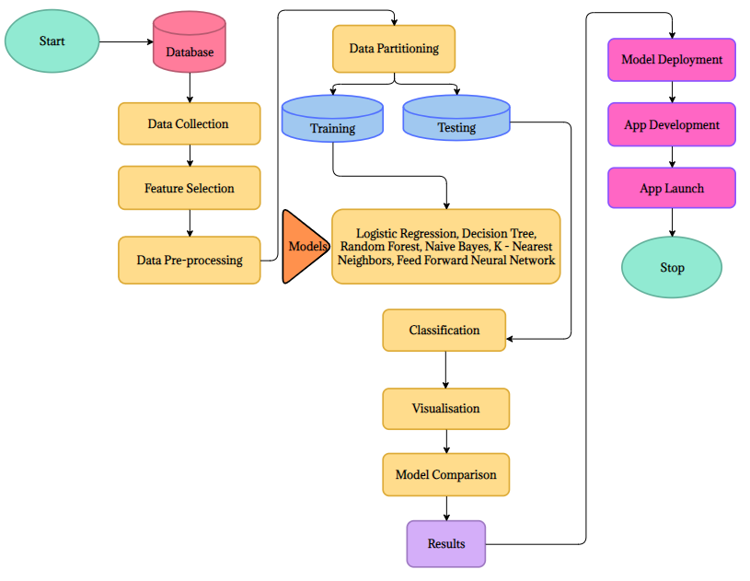
Complete Workflow
Notes:
Data Collection: The data used to detect income tax fraud was obtained from the OpenML repository. The dataset included variables such as age, workclass, fnlwgt, education, education-num, marital-status, occupation, relationship, race, sex, capital-gain, capital-loss, hours-per-week, native-country, and income.
Feature Selection: The most important variables for detecting income tax fraud were selected using techniques like correlation analysis, feature importance, or domain knowledge. In this study, the selected features were age, workclass, race, sex, native-country, income (Demographic factors) and hours-per-week, education, marital-status, occupation, relationship (Behavioral factors).
Data Pre-processing: The data was pre-processed by removing missing values, outliers, and irrelevant variables. Additionally, feature scaling, normalization, and encoding categorical variables were performed.
Data Partitioning: The data was split into training and testing sets to train the models and evaluate their performance.
Model Training: To prove that Logistic Regression is the most suitable model. 5 different models such as Decision Tree, Random Forest, Naive Bayes, k-Nearest Neighbors, and Feed Forward Neural Network, were trained along with Logistic regression on the selected features using the training data.
Model Evaluation: The performance of the trained models on the testing data was evaluated using metrics like accuracy, precision, recall, and F1 score to measure how well the model was performing in detecting income tax fraud.
Visualization: A visualization was created to compare the performance of different algorithms. Bar plots were used to compare the accuracy scores of different models, ROC curves to see which model performs better with an area under the curve (AUC), and precision-recall curves that compare precision and recall.
Model Comparison: The performance of each algorithm was compared to determine which algorithm performs the best.
Model Deployment: The best model is implemented in Android Studio using the TensorFlow library.
Application Development: The app's user interface is created through App view. Our implementation consists of three XML layout files that define the user interface. The app controller serves as the intermediate component between the Model and View elements, managing data flow and event handling.
App Launch: Upon running the application, the source code and resources are compiled into an APK. After installation, Android initiates the app by creating an instance of the main activity, which is then displayed on the screen.

Slide 6
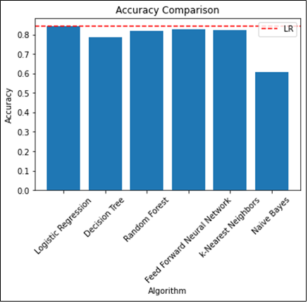
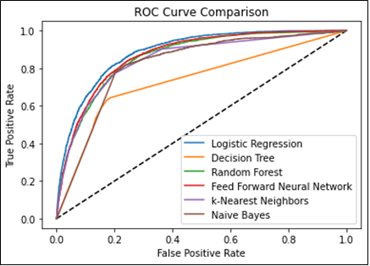
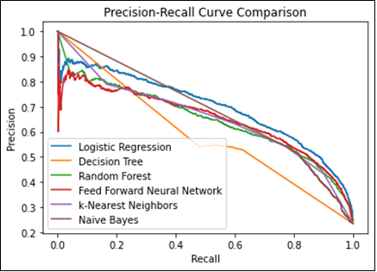
Results Achieved
Notes:
Slide – 6:
These are the results of the visualization. The first visualization is a bar plot that compares the accuracy of each model. The red horizontal line represents the accuracy of the logistic regression model, and it's added to provide a reference point for comparison. The second visualization is an ROC curve, which shows the performance of the classifiers at different threshold levels. The code uses sklearn's roc_curve function to calculate the false positive rate and true positive rate for each model and then plots them against each other. The third visualization is a precision-recall curve, which shows the trade-off between precision and recall at different threshold levels.

Slide 7
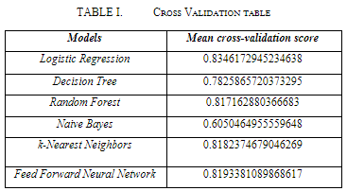
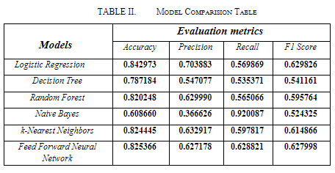
Results Achieved
Notes:
Next, we optimize the performance of the best-performing model with hyperparameters using the GridSearchCV method from scikit-learn. The hyperparameters being tuned are the regularization strength parameter "C" of the logistic regression algorithm. After the hyperparameters are tuned, the best estimator model is selected based on the average score obtained across all folds of the cross-validation. The logistic regression model's prediction probabilities were used to identify suspicious fraudsters based on a threshold value of 0.35, and 2769 records were recognized as suspicious of committing income tax fraud.
Finally, the performance of each model is compared using evaluation metrics.

Slide 8

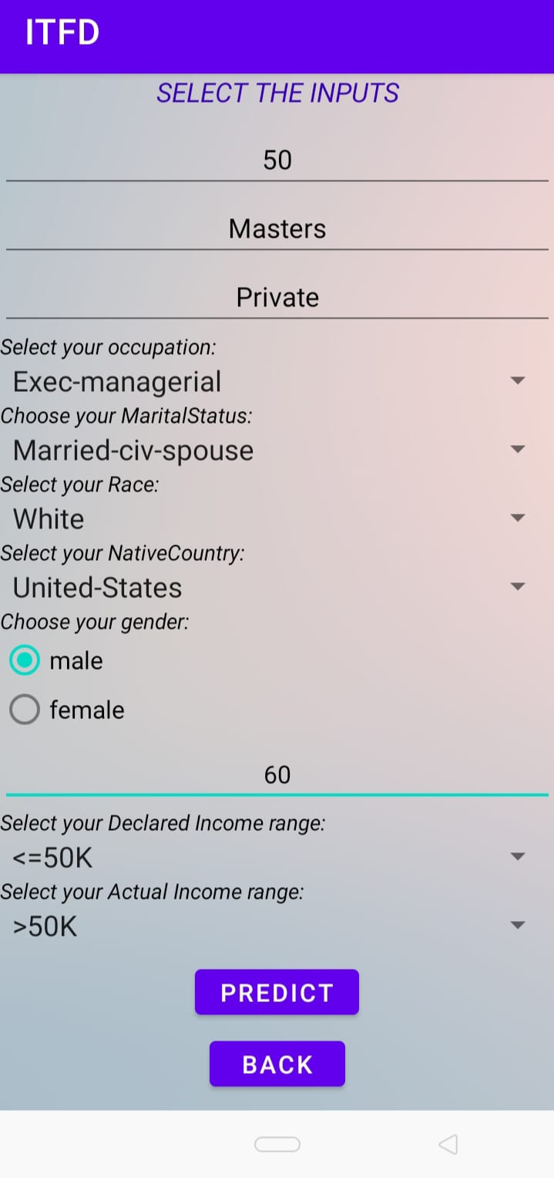

Results Achieved
Login Screen
Input Screen
Display Screen
Notes:
Login Screen:
The user opens the app and is presented with the Login Screen.
After entering the credentials such as username and password by tapping the submit button.
The Main Activity verifies the credentials and, if successful, transitions to the Input Screen.
Input Screen:
The user selects the input values using the Edit Text, AutoComplete Text View, Radio button and Spinner controls by tapping the Predict button.
The Prediction Activity calls the Classifier class to generate the predicted result.
The Classifier class processes the input values and returns the prediction result to the Prediction Activity.
The Prediction Activity transitions to the Display activity and passes the predicted result to the Display Activity.
Display Screen:
The Display Activity retrieves the prediction result and displays it in the Text View.

Slide 9
Future Enhancement
Our Future improvements include modifying the app so that it can use actual amounts rather than a range for the income and try to load the app to the Google Play store.
The app is expected to have the potential to significantly reduce the incidence of income tax fraud, thereby increasing the tax revenue for governments and ensuring fairness and equity in the tax system.
It is also expected to be used by tax authorities and financial institutions to identify income tax thieves and allocate their resources more efficiently.

Slide 10
Conclusion
Tax fraud is the intentional falsification of information on a tax return by some individuals to reduce their tax liability. Finding a cost-effective solution to the problem of tax fraud is one of the top priorities for local tax authorities.
We have proposed a Machine Learning-Based approach for detecting cases of income tax fraud by OpenML Income data and preform a comparative analysis using 6 different algorithms.
The best performing model was then deployed in Android Studio using Tensor flow to develop an app to predict a person being suspicious of committing income tax fraud.
In conclusion, we have created an accurate and efficient way to find a person being suspicious of committing income tax fraud, which can aid in financial planning, market research, and other areas.

Slide 11

Demo

Slide 12
Thank You

